Slide 1
Adaptive Reports Overview

Slide 2
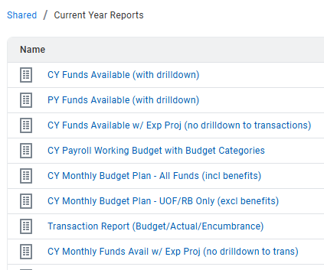
Most used Adaptive Reports

Slide 3
Mid Year Report
Per CSU policy, we are required to review these reports and note any discrepancies, deficits and resolutions.
This is our opportunity to ensure revenues look to be on track. i.e cr monthly. i.e bill submittal on time.
At this point actuals for salaries are expected to be at 50% of budget.
This is a high-level review where immaterial variances are expected, i.e. no budget for an occasional $3,000 expense.
The goal is to have a clean quarter close every three months, but December is particularly important because it is the month we take a permanent picture of how mid-year closed and this is the first formal review of the fiscal year for divisions.

Slide 4
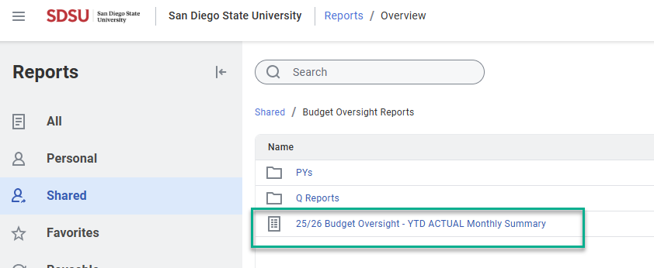
Mid Year Report

Slide 5
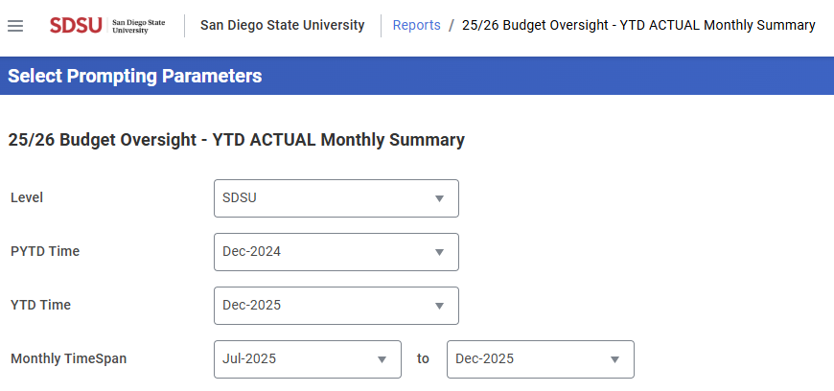
Mid Year Report parameters

Slide 6
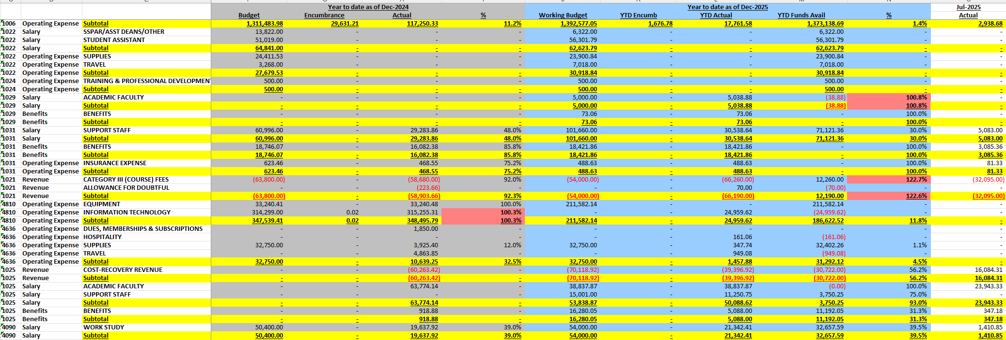
Mid-year report example

Slide 7

Mid-Year Report Process
Review budget reports through December financial close
Analyze variance and trends
Note any issues and questions.
Take immediate action to resolve any issues by submitting budget transfers/LDAs/expenditure transfers.

Slide 8

When reviewing reports monthly
Validate data
1
Submit any corrections
2
Review and confirm corrections are posted
3

Slide 9
Periodic Deadlines
Labor Distribution Adjustments (LDAs) Deadlines: | For charge periods through: | Expenditure Transfers (ETs) Deadlines: | For transactions through:
9/26/25 | 202508 | 1/14/26 | 10/31/25
12/29/25 | 202511 | 2/16/26 | 12/31/25
2/14/26 | 202601 | 4/21/26 | 3/31/26
4/15/26 | 202603 | 5/20/26 | 4/30/26
5/22/26 | 202604 | 6/10/26 | 5/31/26

Slide 10
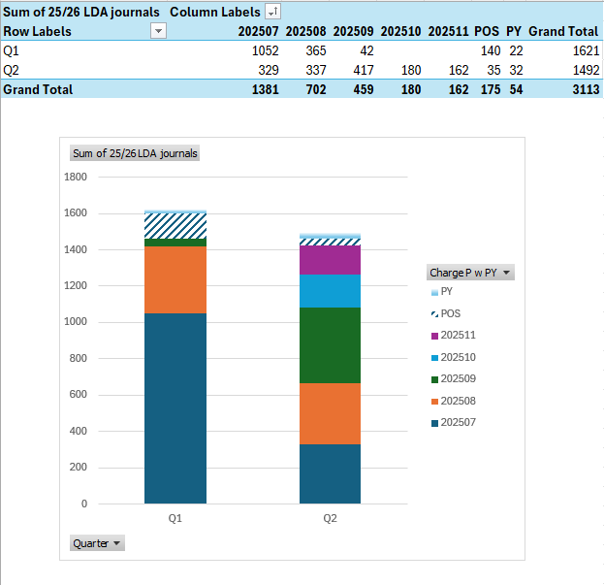
LDAs processed through Q2

Slide 11

Position Incumbent Report
~ Review it monthly to avoid LDAs ~
Path to find it in PeopleSoft:
You can “Add to Favorites” by clicking this option located in the top right corner:

Slide 12
Override Requests

Slide 13
Thank You!
~ Any questions? ~

